Slide 1
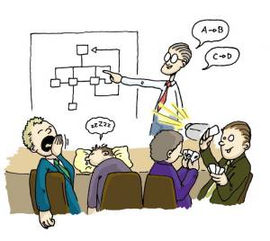
Facing the Crowd:
A Presentation about Presentations
This presentation brought to you by Chapter 14, Writing That Works.

Slide 2
What Is Your Group’s Purpose?
To share information
To urge an audience to take action
To analyze data
To present solutions to a problem
Create a purpose statement.

Slide 3
Who Is the Audience?
What is their level of knowledge about the topic?
What is their general educational level and age?
What is their attitude toward the topic?
Based on that attitude, what interests, concerns, fears, or objections might they have?
Do they have different concerns or needs?
What questions might they ask about this topic?

Slide 4
What Information Do You Include?
Find information that supports your purpose
Determine the most persuasive information
Data?
Experience?
Visuals?

Slide 5
Structuring the Presentation: Intro
Try to catch and focus the audience’s attention.
Problem definition
Catchy statement
Rhetorical question
Personal experience
Appropriate quotation
Provide an overview of the presentation.

Slide 6
Structuring the Presentation: Body
Persuade your audience.
Offer a solution
Prove your point
Call for action
Anticipate questions and objections

Slide 7
Structuring the Presentation: Closing
Achieve presentation goals
Be strong and persuasive
Field questions

Slide 8
Visual Aids
Clarify and simplify your message
Communicate quickly and vividly

Slide 9
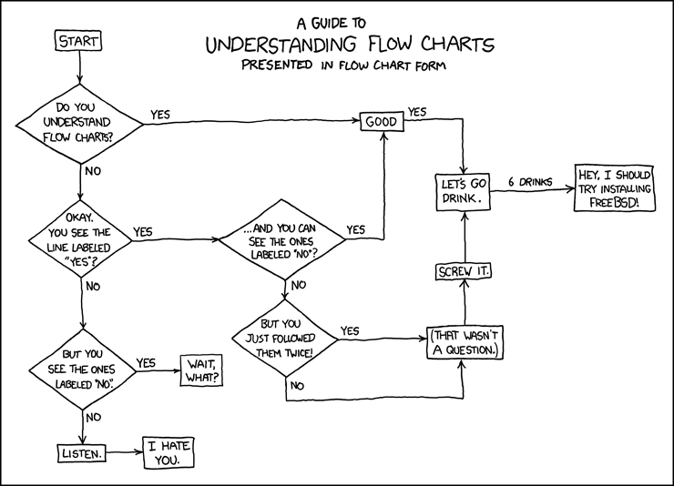
Visual Aids
Charts, graphs, and illustrations can increase
audience understanding and retention.

Slide 10
Mediums: Presentation Software
Presentation software permits you to create your slides as you
write your presentation. You can import content and visuals
from other files, and you can use standard templates that help
you design effective visuals. You can manipulate layouts,
typefaces, background textures, colors, clip-art images, sound
and music, and video. and colors. However, presentation
software can lend itself to user dependency. You never (ever)
want to create a slide that looks like this and then read it
word for word.
Use text sparingly on slides (40-45 words)
Instead of blocks of text, use bulleted or numbered lists

Slide 11
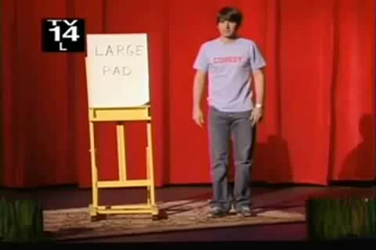
Mediums: Flipcharts & Whiteboards
Ideal for smaller groups
Encourage brainstorming and interaction
Facilitate note-jotting

Slide 12
Mediums: Handouts
Handouts accommodate listeners, allowing them
to take notes and clarify any misunderstandings.
Paper copies of your presentation slides
Summary of key points
Supporting data in tables, charts, and graphs

Slide 13
Practice, Practice, Practice
Familiarize yourself with the material
Practice on your feet and out loud
Clarify any awkward wording
Help reduce verbal tics (umm…)
Integrate visuals into your practice sessions

Slide 14
Delivery
Make eye contact
Use movements and gestures
Vary vocal inflection, pace, and projection
Vocal inflection: the rise and fall of your voice.
Pace: how quickly or slowly you speak.

Slide 15
Being a Good Listener
To listen more effectively…
make a conscious decision to listen actively
think about your purpose for listening
take specific actions to list more efficiently
adapt to the situation

